Slide 1
Quantum Cryptography

Slide 2
Quantum World: It’s Bizarre!
Superposition
Alive-and-Dead Cat
Collapse
Measurement affects quantum state
Uncertainty
A Theoretical Limitation
Indistinguishability
Non-orthogonal states aren’t fully distinguished
No-Cloning
Arbitrary unknown states cannot be reliably copied
Entanglement
Spooky effect at a distance
Parallelism
Beware of Tensors: Dimensions Multiply!

Slide 3
An Experiment with Photons
The Three Polarizers

Slide 4
The Photon Experiment

Slide 5
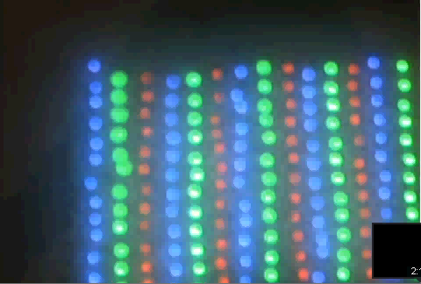
The Photon Experiment (Contd.)

Slide 6
Qubits
An Explanation

Slide 7
Qubits
A quantum bit, or qubit, is a unit vector in a two dimensional complex vector space for which a particular basis has been fixed and is denoted by:
{|0›, |1›}
Qubits can be in a superposition of |0› and |1› such as
a|0› +b |1›
where a and b are complex numbers such that |a|² + |b|² = 1.

Slide 8
Measuring a Qubit in the Basis
For the qubit
a|0› +b |1›
the probability that the measured value is |0› is
|a|²
after which the state collapses to |0› and
the probability that the measured value is |1› is
|b|²
after which the state collapses to |1›

Slide 9
Qubit Model Correctly Predicts the Outcome of Photon Experiment
and several other experiments too!

Slide 10
No-Cloning Theorem
Assume that U is a unitary transformation that clones, in that U(|a0›) = |aa› for all quantum states |a›.
Consider |c› = (1/√2)(|a› + |b›).
Then,
U(|c0›) = 1/√2 (U(|a0›) + U(|b0›)) = 1/√2(|aa› + |bb›)
But if U is a cloning transformation then
U(|c0›) = |cc› = 1/2(|aa› + |ab› + |ba› + |bb›)
A contradiction.

Slide 11
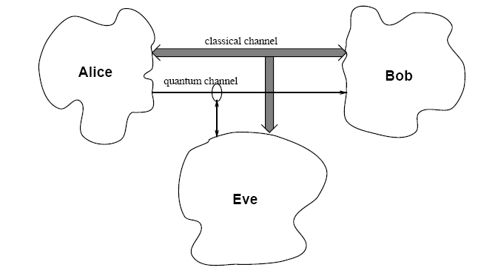
Quantum Secret Key Establishment Protocol
The Standard Setting

Slide 12
Quantum Secret Key Establishment Protocol
Two conjugate bases are used, say b₁ and b_{2.}as shown in the table.
S chooses a random base, and based on the bit to send, it sends a qubit prepared in the corresponding state.
R measures the qubit received, with a random base. If the base is different from what S used, the bit is lost, else R measures the actual bit.
Bit | 0 | 1
b₁
b₂
Notes:
12

Slide 13
Quantum SKEP (Contd.)
This process is repeated for all the bits.
S and R publicly compare (through a classical channel) their respective bases, and discard all those bits where their bases were different.
The bases are same for nearly half the number of bits.
S and R now check whether adversary has intercepted (measured) any of these bits, by comparing a certain subset of the remaining bit strings.
If more than p (what should this be?) bits differ, they abort the key and repeat the process.
Notes:
13

Slide 14
Quantum Money
Impossible to Counterfeit

Slide 15
Quantum Money Problem (Informal)
A quantum money scheme is a scheme in which
quantum banknotes can be efficiently produced by a central bank
there exists a polynomial-time quantum algorithm for authenticating the banknotes, which could be private or public, and
given as input k valid banknotes, a polynomial-time counterfeiter cannot produce k + 1 valid banknotes that have non-negligible probability of passing the authentication test.

Slide 16

Wiesner’ Protocol
“Quantum banknote”
- unique serial number
- states of
Secured bank database
- serial number
- classical description of quantum states

Slide 17

Wiesner’ Protocol (Contd.)
On receipt of a banknote
- database has classical descriptions of qubits to the corresponding serial number
- qubits are measured to verify the authenticity
Security
- can we make/forge a new banknote which passes authentication?
- yes, but success probability of such a banknote is

Slide 18
Wiesner’ Protocol (Contd.)
Advantages:
- coherent single qubits
- one-qubit measurements
- information-theoretic security
Drawbacks:
- giant secure database required

Slide 19






BBBW Protocol
A fixed secret random seed ‘s’
Banknote:
- unique serial number
- pseudorandom function
- is grouped in to blocks of 2 bits.
- each block is mapped as below to form

Slide 20
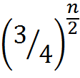
BBBW Protocol (Contd.)
On receipt of a banknote
- compute
- measures each qubit of in appropriate basis
Security
- can we make/forge a new banknote which passes authentication?
- yes, but success probability of such a banknote is

Slide 21

Quantum Money
BBBW Protocol
Advantages:
- no giant database
- no polynomial time quantum algorithm to forge assuming is secure
Drawbacks:
- s must remain a closely-guarded secret
- can’t have public authenticating

Slide 22
Publicly Verifiable Quantum Money
Conjectured solutions exist
For instance, Scott Aaronson’s random stabilizer scheme
Matrix Product state based schemes etc.

Slide 23
References
S. Wiesner. Conjugate coding. SIGACT News, 15(1):78–88, 1983.
C. H. Bennett, G. Brassard, S. Breidbart, and S.Wiesner. Quantum cryptography, or unforgeable subway tokens. pages 267–275. Plenum Press, 1982.
S. Aaronson, E. Farhi, D. Gosset, A. Hassidim, A. Lutomirski, and P. W. Shor. Quantum money using matrix product states, 2009.

Slide 24
Multiple Qubits
Individual state spaces of n particles combine classically through the cartesian product.
Quantum states, however, combine through the tensor product.
A basis for a three qubit system is
{|000›, |001›, |010›, |011›, |100›, |101›, |110›, |111›}
and in general an n qubit system has 2^{n} basis vectors.
We can now see the exponential growth of the state space with the number of quantum particles.

Slide 25
Quantum Entanglement
The state |00› +|11› cannot be described in terms of its components (qubits) separately.
We cannot find a₁, a₂, b₁, b₂ such that
(a₁|0› + b₁|1›) ⊗ (a₂|0› + b₂|1›) = |00› + |11›
= a₁a₂|00› + a₁b₂|01› + b₁a₂|10› + b₁b₂|11›
Means a₁b₂ = 0 which implies that either a₁a₂ = 0 or b₁b₂ = 0.
States which cannot be decomposed in this way are called entangled states.

Slide 26
EPR PARADOX

Slide 27
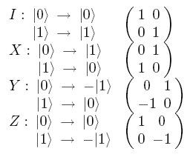
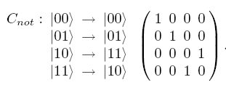

Quantum Gates and Circuits
Five Simple Quantum Gates and C_{not} gate

Slide 28
Quantum Teleportation
The objective is to transmit the quantum state of a particle using classical bits and reconstruct the exact quantum state at the receiver.
Does not contradict no-cloning theorem

Slide 29
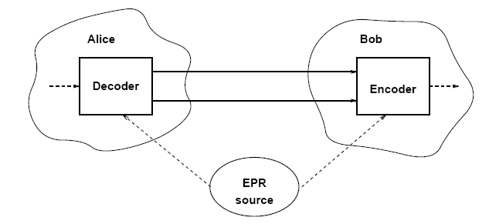
Quantum Teleportation (Contd.): The Setting
Alice has a qubit whose state she doesn’t know. She wants to send the state of this qubit
φ = a|0› + b|1›
to Bob through classical channels.
Alice and Bob each possess one qubit of an entangled pair
ψ₀ = 1/√2(|00› + |11›)

Slide 30
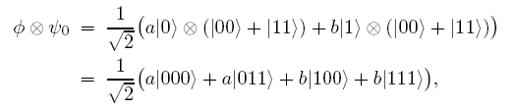
Quantum Teleportation (Contd.)
Initial state is
of which Alice controls the first two bits and Bob controls the last one.

Slide 31
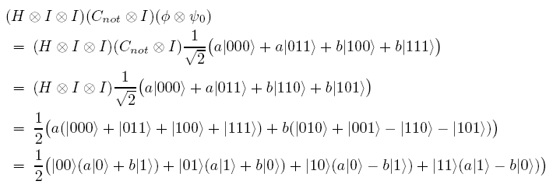
Quantum Teleportation (Contd.)
Alice now applies

Slide 32
Quantum Teleportation (Contd.)
Alice measures the first two qubits
She obtains one of the four outputs with equal probability. Alice sends the result of her measurement as two classical bits to Bob
Alice’s Output | Modified Bob’s Qubit

Slide 33
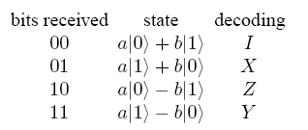
Quantum Teleportation (Contd.)
When Bob receives the two classical bits from Alice he knows how the state of his half of the entangled pair compares to the original state of Alice’s qubit.
Bob can reconstruct the original state of Alice’s qubit, φ, by applying the appropriate decoding transformation to his part of the entangled pair as follows:

Slide 34
EPR PARADOX

Slide 35
DENSE CODING
Sending two classical bits using a single qubit

Slide 36
Dense Coding Protocol
Alice receives two classical bits, encoding the numbers 0 through 3. Depending on this number Alice performs one of the transformations {I,X, Y,Z} on her qubit of the entangled pair

Slide 37
Dense Coding Protocol (Contd.)

Slide 38
Dense Coding Protocol (Contd.)

Slide 39
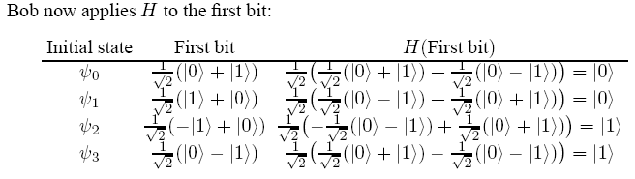
Dense Coding Protocol (Contd.)
Finally, Bob measures the resulting two qubits bit which allows him to obtain Alice’s two classical bits of information

Slide 40
Thank You

